Slide 1
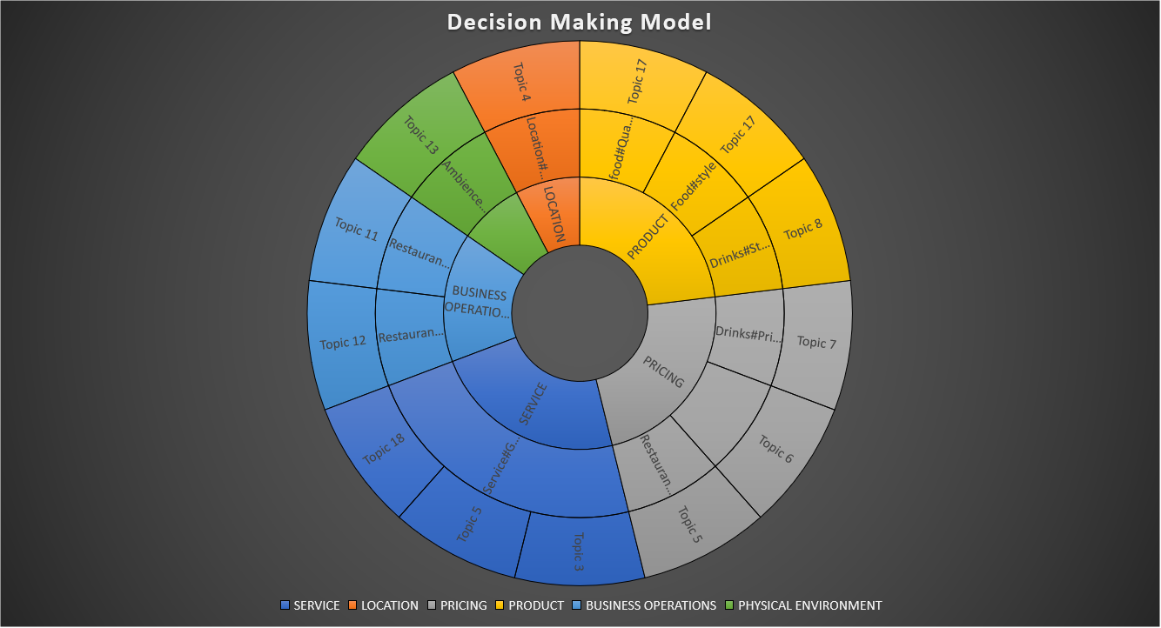

Decision Making Hierarchy
Level 1: Business Aspect
(E.g. Product)
Level 2: Restaurant Aspect
(E.g. Food#Quality)
Diving Deeper to develop
Targeted and Effective improvement/enhancement plans for Restaurant
Level 3: Associated Topic
(E.g. Topic 17: Food Roll/Sushi/Fried Rice/Shrimp)
Level 4: Recommendations
(Hire Right Chef, Invest on R&D)

Slide 2
Business Aspect | Restaurant Aspect | Dominant Topic Theme | Food Mentioned | Recommendations
SERVICE | Service#General | Topic 19: Service_Waiting_Time Topic 18:Customer Service Topic4:Service | NA | Department: Employee Upskill Team
LOCATION | Location#General | Topic 18: Place_Austin | NA | Department: Mangerial Staff Try out New Branch
PRICING | Restaurant#Prices Drinks#Prices Food#Prices | Topic 18: Food Drinks | NA | Department: Pricing Manager/Strategist Pricing Strategies
PRODUCT | Food#Quality | Topic 17: Food Roll/Sushi/Fried Rice/Shrimp Topic 5:Food Sushi Topic 4: Food_ChickenSauce | 'sushi', 'roll', 'edamame', 'rice', 'chickenrice', 'bangbangshrimpbun', 'pokebowl', | Department: Kitchen Staff Hire the right chef
PRODUCT | Food#Style_Options Drinks#Style_Options | Topic 17: Food Roll/Sushi/Fried Rice/Shrimp Topic 5:Food Sushi | 'sushi', 'roll', 'edamame', 'rice', 'chickenrice', 'bangbangshrimpbun', 'pokebowl', | Department: R&D Deparmtnet Invent wide variety of options of food/drinks
BUSINESS OPERATIONS | Restaurant#General | Topic_18:Clean Environment Topic 4:Food Ordering/Cold Temperature | NA | Department: R&D Deparmtnet Invent wide variety of options of food/drinks
PHYSICAL ENVIRONMENT | Ambience#General | Topic_18:Clean Environment Topic 20: Envrionemnt_Decor_Patio_lighting _Music | NA | Department: Managerial Staff Use congruent and fit atmospheric elements to create a unique servicescape
**Topic 18 happens to be overlapping topic

